Slide 1
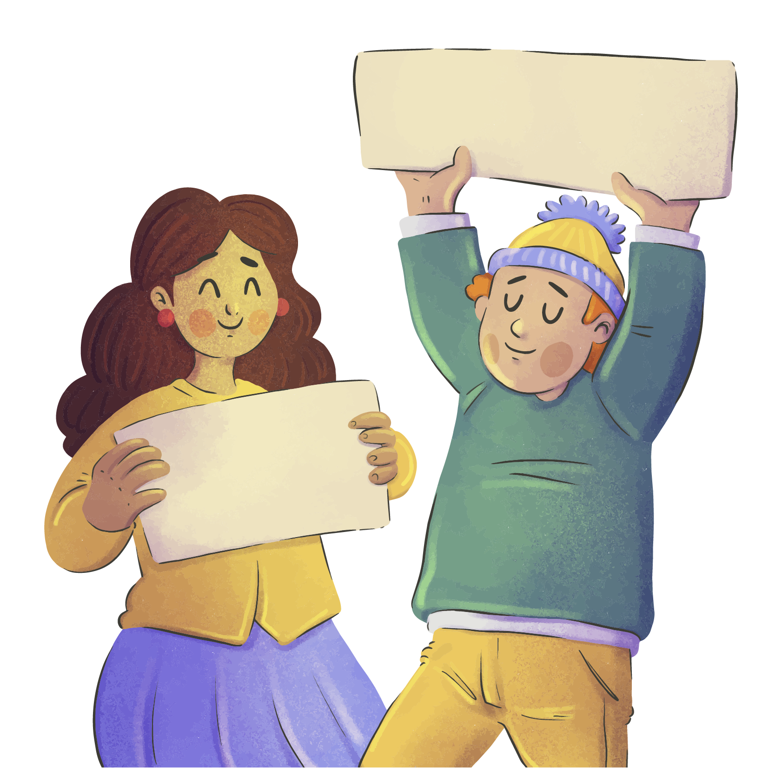
SKIN
I HAVE
BY Team THE DREAMERS
A DREAM
Theme: HUMAIN RIGHTS

Slide 2
Outlines
01
03
02
Presentation of the team
The plot
Coat of arms
04
05
The characters
The Setting

Slide 3
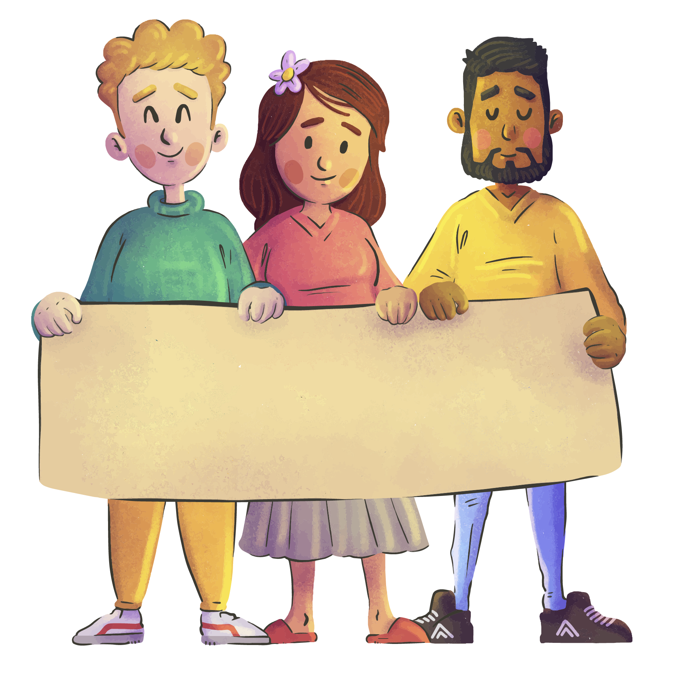
01
Presentation of the team
THE DREAMERS

Slide 4
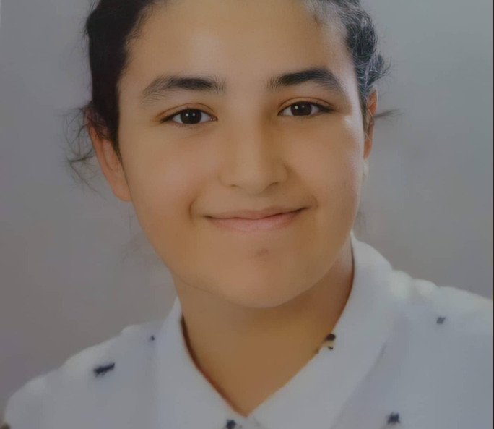
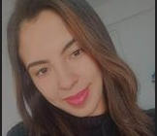
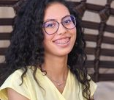
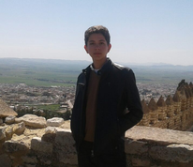
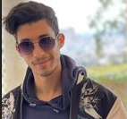

OUR TEAM
Fatma BEN KHEDHER
Tayssir BEN NEJMA
Aycha SABER
Ali ZOUAOUI
Rayen NASRI

Slide 5


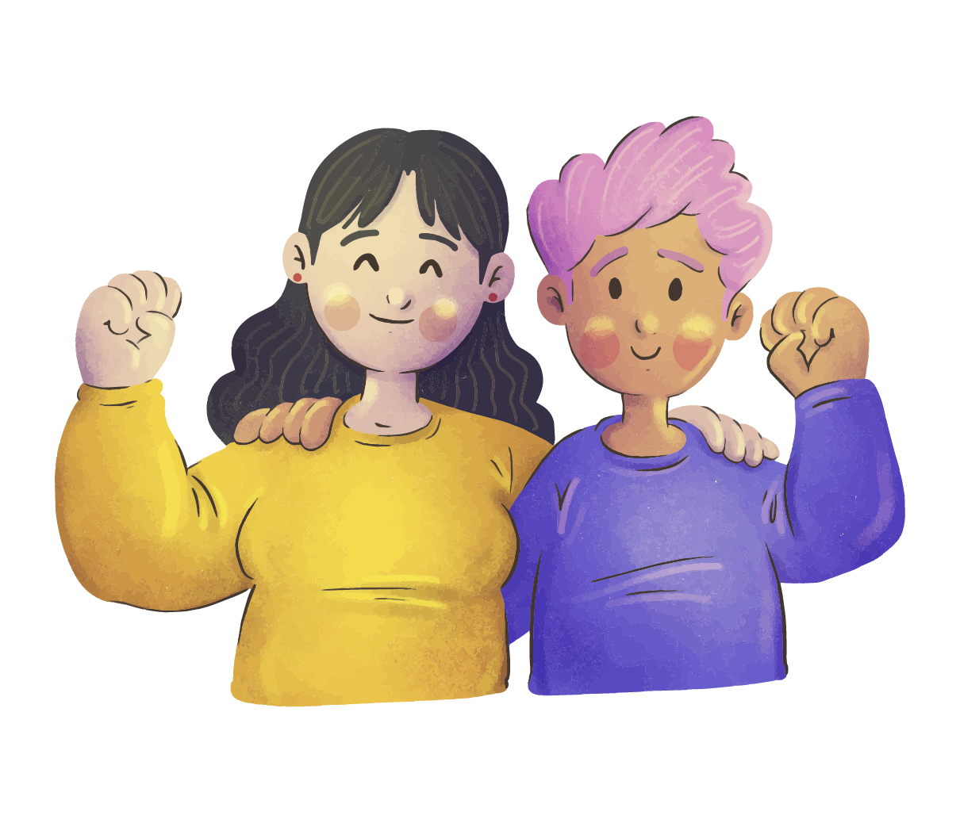
coat of arms
02

Slide 6




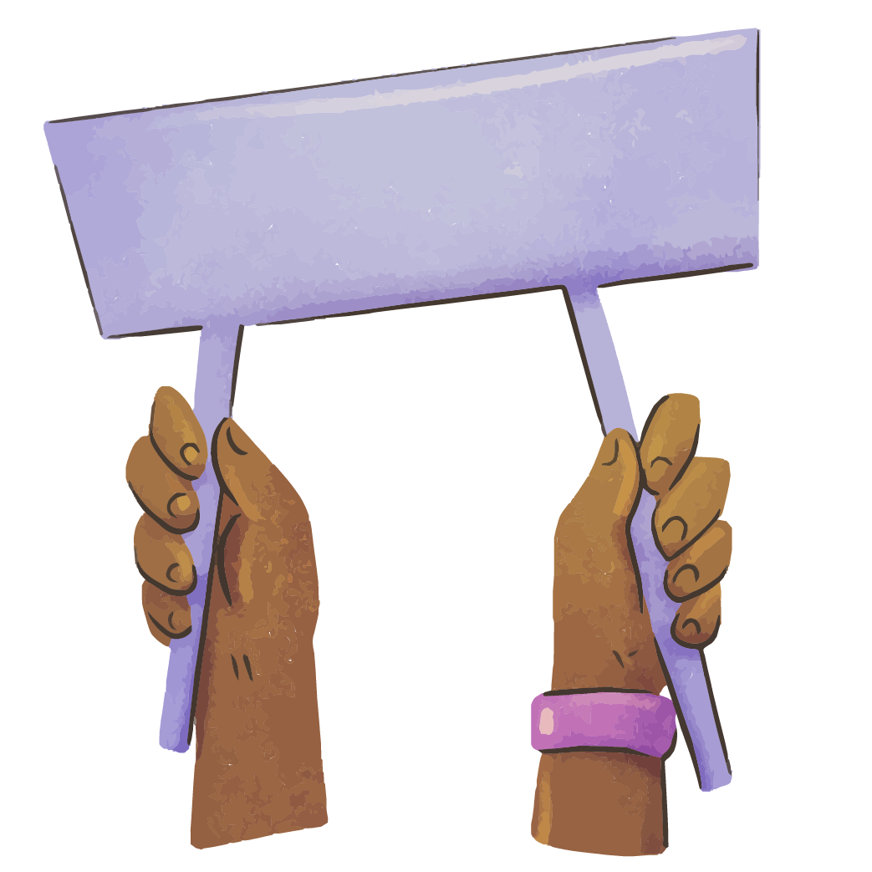
Our teams coat of arms
JUSTICE
PEACE
Truth
Hope!

Slide 7
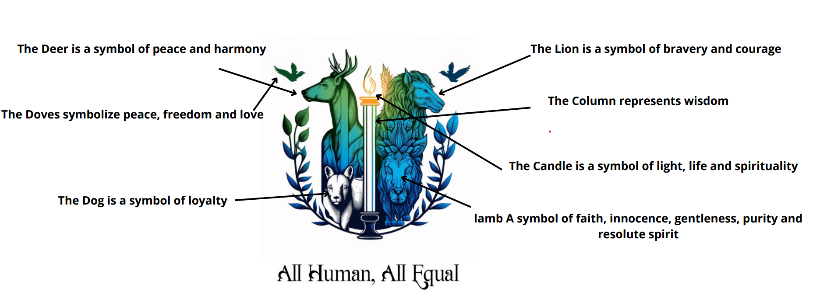
Our teams coat of arms

Slide 8
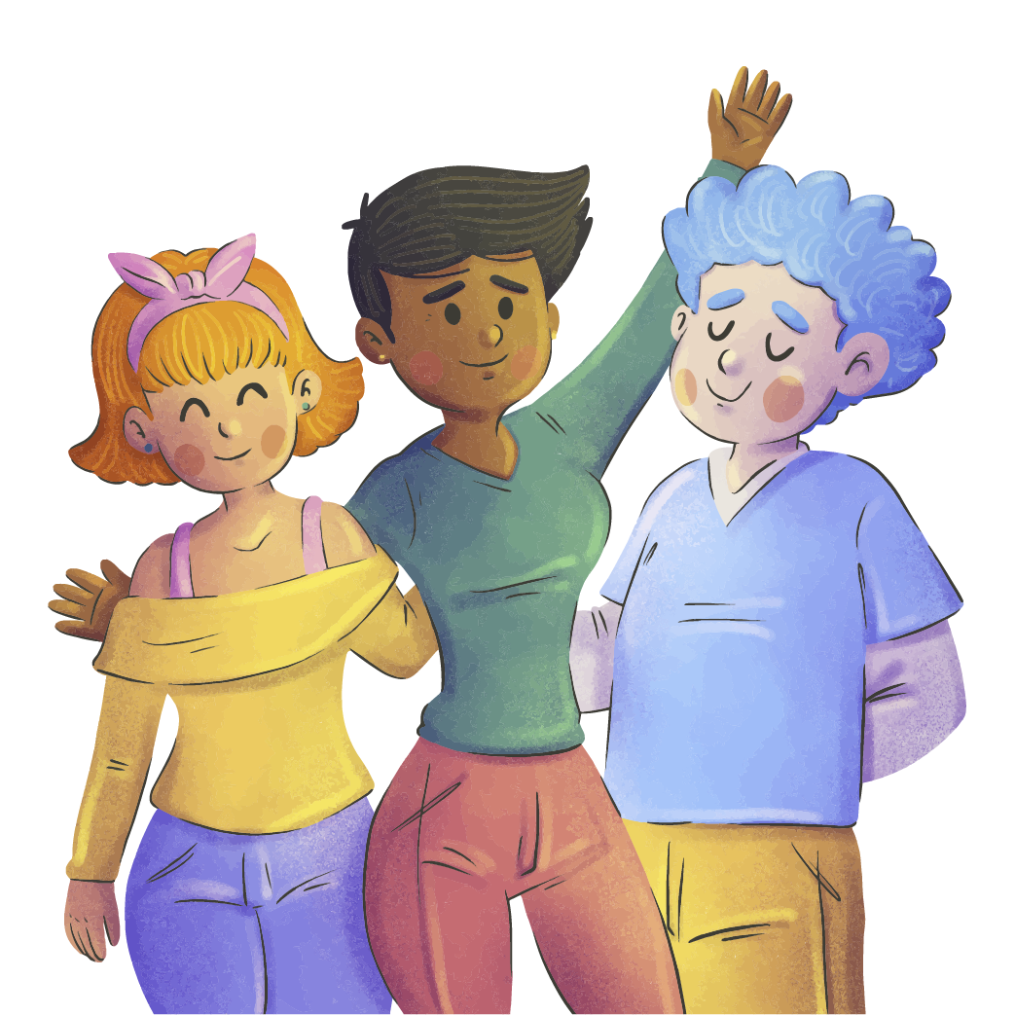
The plot
03

Slide 9

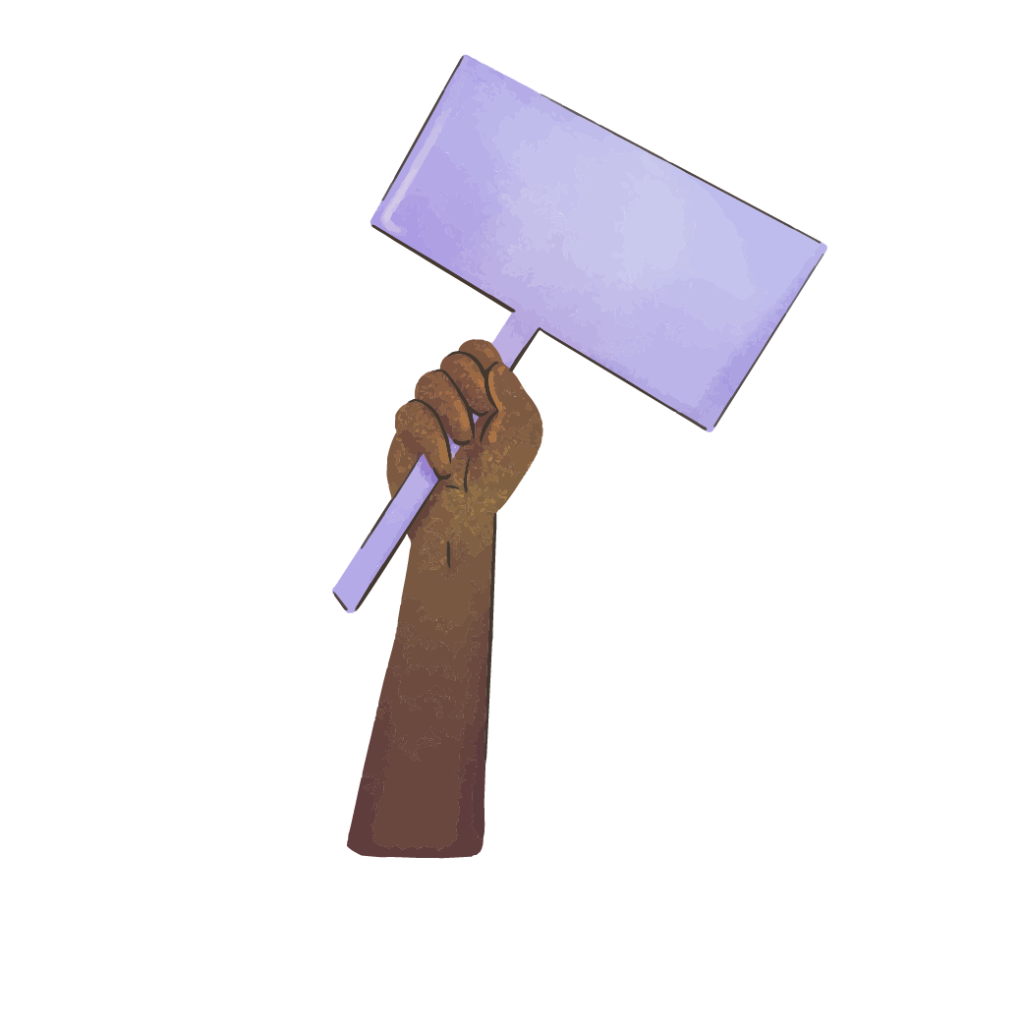
The plot : (plot type:Overcoming the monster )
Exposition: John and Adam are two close friends who live in a village where the villagers with dark skin have to pay half of their monthly earnings to the ruling family
Climax: Adam's son dies, he leaves his dad behind feeling oppressed and miserable
Rising action: Adam's son gets sick yet he couldn't afford the necessary medical treatment
Falling action: John convinces the villagers to stand up and fight for their brothers and sister's rights demanding equal treatment for all regardless of skin color
Resolution : the law gets overturned the village becomes more inclusive and equal place where everyone was valued and respected regardless of their differences
Justice
All equal

Slide 10

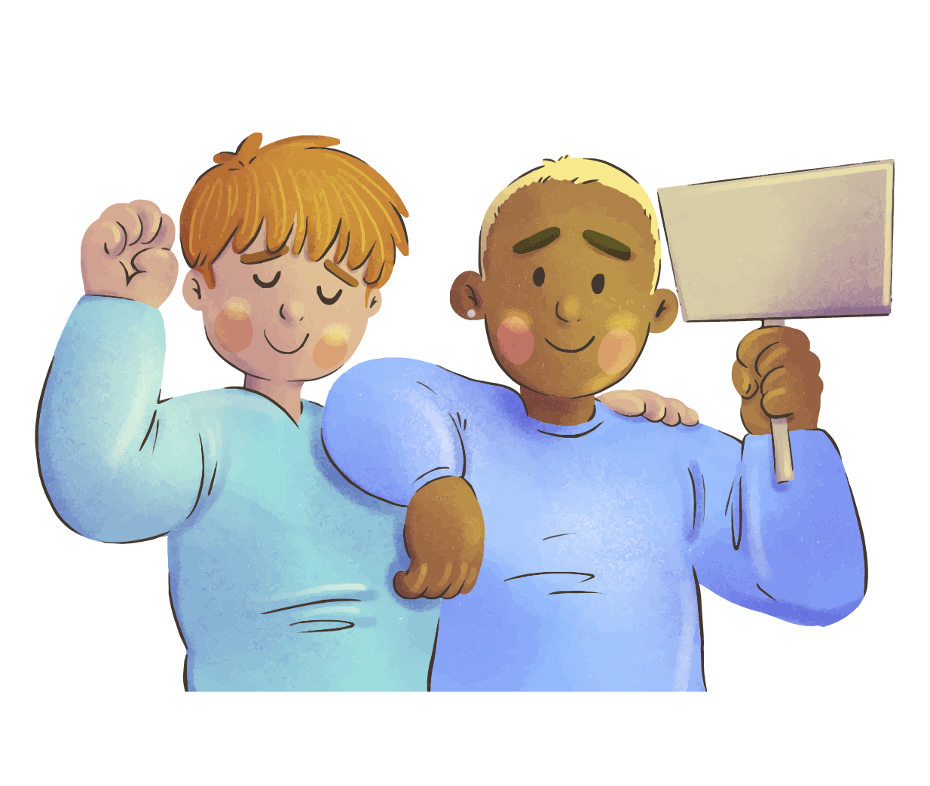
04
The characters
EQUAL

Slide 11

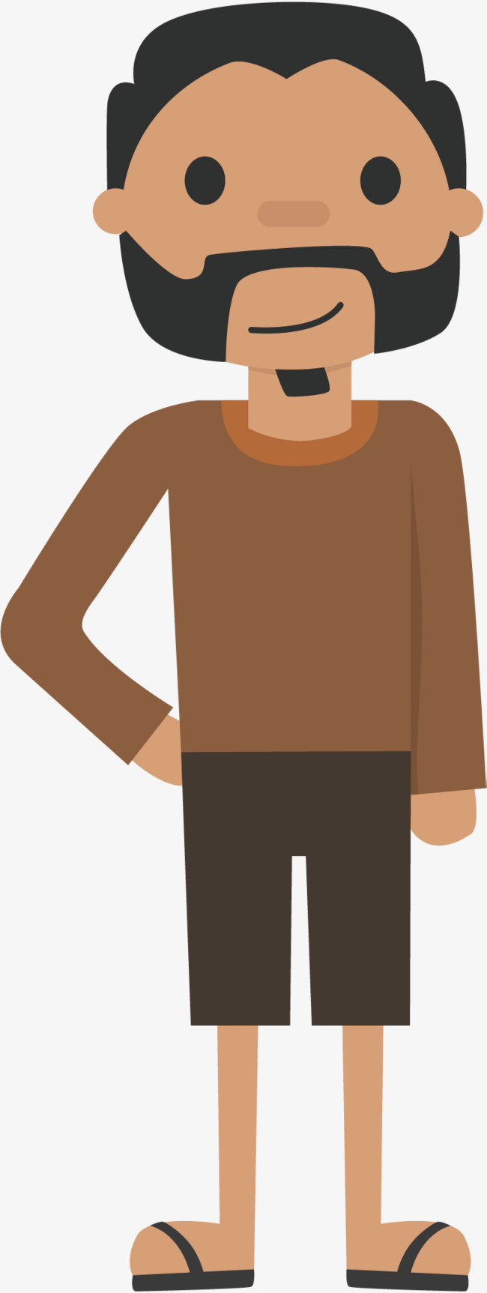
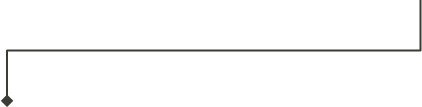
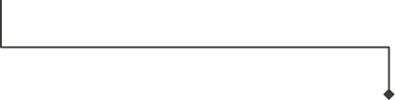
Adam
Physical:
-tall
-Round face
-in his forty
-short hair
-large mouth
-small nose
Personality:
-polite
-quite
-peaceful
-kind
Adam couldn’t afford the money to save his son from his sickness in revenge he try his best to overturn the law

Slide 12
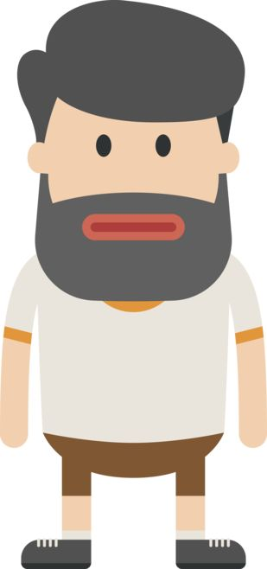
John
Physical:
-short
-Round face
-in his thirty
-long hair
-big mouth
-small nose
Personality:
-altruistic
-strong
-humble
-kind
John tries to take revenge for his poor friend he convinces
villagers to speak up for the humanity

Slide 13
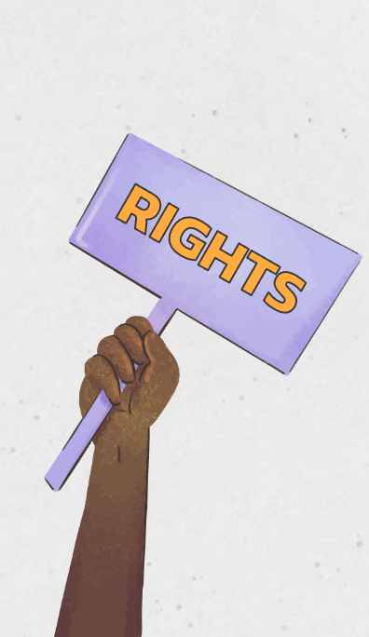
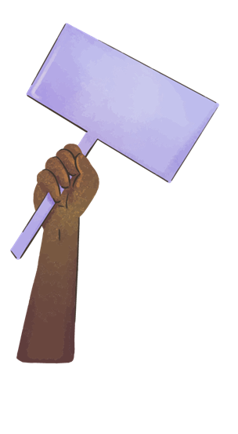
The settings
Where?

Slide 14


The where and when?
Place:
Time:
The story takes place in a village which was located in a remote area, far from any major cities or towns
The story takes place a long time ago

Slide 15
The mood
The author tries to convey a feeling of suspense throughout the story while also trying to get the listener/reader to empathize with the village population

Slide 16
Riddles !!
Fun!
Have
Time for some fun..

Slide 17
Everyone wants me yet i can’t be sold ,as should you sell me i will be wraped.I never come first ,yet i’m never last .i represent the present,the future,but not the past ,who am i ?
Justice
Can you
Guess it?

Slide 18
I am the moment you find peace, a feeling of sorts that brings clamness to your soul
Acceptance

Slide 19

I want justice ,peace and revenge for all ,who i am ?
Nobody
John
Adam
I lost a lot , yet I have to fight for all,who i am ?
John
Rulling family
Adam

Slide 20
I want justice ,peace and revenge for all ,who i am ?
John
I lost a lot , yet I have to fight for all,who i am ?
Adam

Slide 21

Thank you for your attention
Peace
Love

